Slide 1
Django and MySQL
C393: Database Systems

Slide 2
Lesson Objectives
Query a database using an ORM tool
Query a database from python directly

Slide 3
Object-Relational Mapping
Converts database records to in-memory representations in the language of choice
Allows easy CRUD operations
Create
Read
Update
Delete
Helps enforce DRY principle - Don’t Repeat Yourself

Slide 4
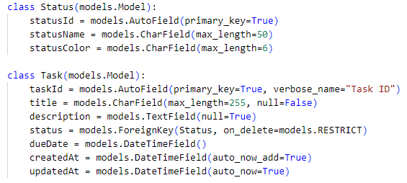
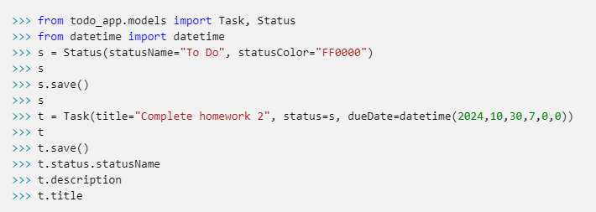
An Example
Python Definitions
Create/Read

Slide 5
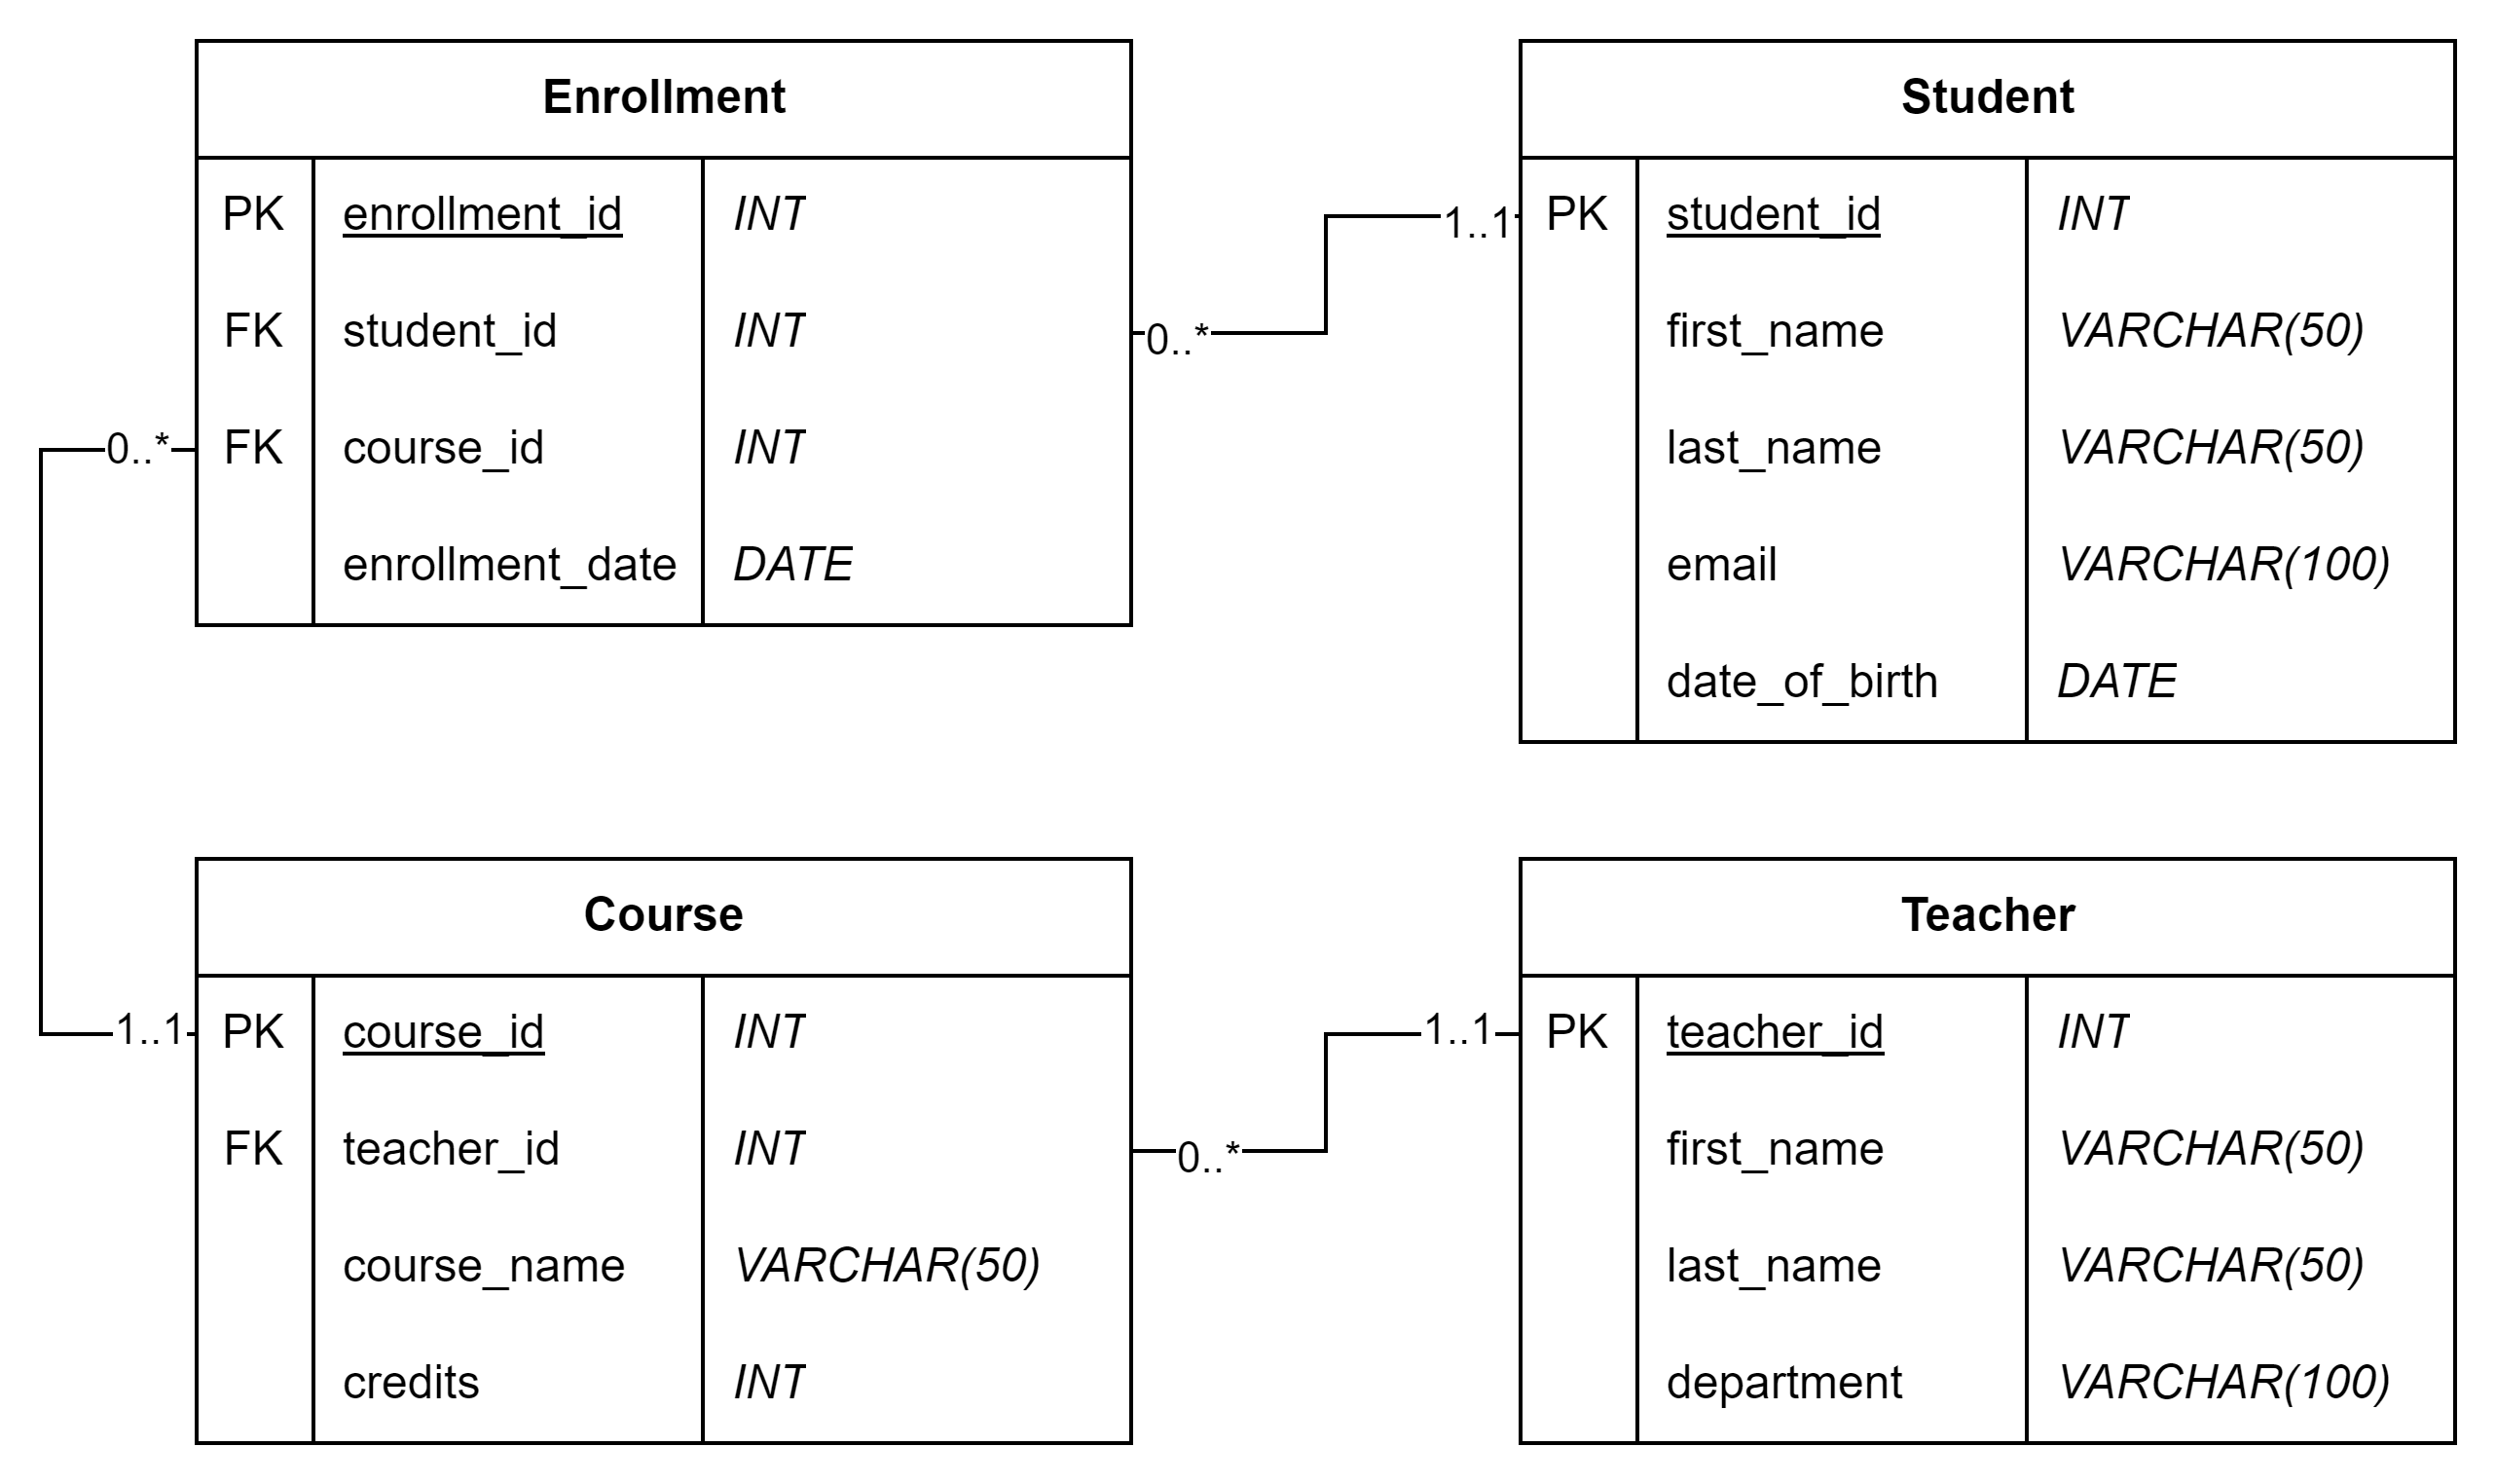
Our Schema

Slide 6
Create
MySQL
Django
CREATE TABLE Students (
student_id INT PRIMARY KEY AUTO_INCREMENT,
first_name VARCHAR(50),
last_name VARCHAR(50),
date_of_birth DATE, email VARCHAR(100) );
class Student(models.Model):
first_name = models.CharField(max_length=50)
last_name = models.CharField(max_length=50)
date_of_birth = models.DateField()
email = models.EmailField(unique=True)
def __str__(self):
return f"{self.first_name} {self.last_name}"
Notes:
Have to issue the migrate Django command after changing the model

Slide 7
Create
MySQL
Django
INSERT INTO Students VALUES ('Kobe',
'Bryant', '1978-08-23',
'kobe.bryant@lakers.com');
kobe = Student(
first_name="Kobe",
last_name="Bryant",
date_of_birth = date(1978, 8, 23)
email="kobe.bryant@lakers.com"
)
kobe.save()
Notes:
Have to issue the migrate Django command after changing the model

Slide 8
Update
MySQL
Django
UPDATE Students SET first_name = ‘Ethan’
WHERE student_id = 5;
student = Student.objects.get(student_id=5)
student.first_name = 'Ethan'
student.save()
OR
Student.objects .filter(student_id=5) .update(first_name='Ethan')
Notes:
First Django option issues a SELECT statement first, then the UPDATE statement
Second Django option only issues the UPDATE statement

Slide 9
Delete
MySQL
Django
DELETE FROM Students
WHERE student_id = 5;
student = Student.objects.filter(student_id=5)
student.delete()
OR
Student.objects .filter(student_id=5) .delete()
Notes:
First Django option issues a SELECT statement first, then the DELETE statement
Second Django option only issues the DELETE statement

Slide 10
Read…
MySQL
Django
SELECT * FROM Students
all_students = Student.objects.all()
print(all_students)
Notes:
All students

Slide 11
Read… WHERE
MySQL
Django
SELECT * FROM Students
WHERE student_id=5
student = Student.objects.filter(student_id=5)
print(student)
Notes:
Students whose student_id is 5

Slide 12
Read… WHERE
MySQL
Django
SELECT *
FROM Courses
WHERE credits > 3;
hard_courses = Course.objects.filter(
credits__gt=3
)
print(hard_courses)
Notes:
Courses worth more than 3 credits

Slide 13
Read… ORDER BY
MySQL
Django
SELECT * FROM Students
ORDER BY last_name DESC;
students = Student.objects.order_by('-last_name’)
print(students)
Notes:
Students ordered by last name desc

Slide 14
Read… INNER JOIN
MySQL
Django
SELECT * FROM Courses AS c INNER JOIN Teachers AS t ON c.teacher_id = t.teacher_id
all_teachers = Teacher.objects.all()
for teacher in all_teachers: print(teacher, teacher.course_set.all())
Notes:
All courses and their teachers (or all teachers and their courses)

Slide 15
Read… INNER JOINs w/WHERE
MySQL
Django
SELECT s.* FROM Courses AS c INNER JOIN Enrollments AS e ON c.course_id = e.course_id
INNER JOIN Students AS s
ON s.student_id = e.student_id
WHERE c.course_name
= ‘Data Structures’;
ds_students = Student.objects.filter( enrollment__course__course_name='Data Structures’ )
print(ds_students)
Notes:
All Students enrolled in Data Structures

Slide 16
Your Turn
In the interpreter... (or a .py file)
Create a student
Update a teacher
Delete a student
All teachers
Students born before 2003, sorted by date_of_birth
Students and all their enrollment dates
from school_app.models import Student, Enrollment, Course, Teacher
from datetime import datetime, date

Slide 17
Read… OUTER JOIN
MySQL
Django
SELECT * FROM Students AS s LEFT JOIN Enrollments AS e ON s.student_id = e.student_id
all_students = Student.objects.all()
for student in all_students:
print(student, student.enrollment_set.all())
Notes:
All students and their enrollments, even if they’re not enrolled in any classes

Slide 18
Read… OUTER JOIN w/IS NULL
MySQL
Django
SELECT s.* FROM Students AS s LEFT JOIN Enrollments AS e ON s.student_id = e.student_id
WHERE e.student_id IS NULL;
no_class = Student.objects.filter(enrollment__isnull=True)
print(no_class)
Notes:
Only students not enrolled in a class

Slide 19
Read… GROUP BY
MySQL
Django
SELECT teacher_id, AVG(credits)
FROM Courses
GROUP BY teacher_id
from django.db.models import Avg
teacher_credits = Teacher.objects.annotate(
avg_credits=Avg('course__credits’) )
for teacher in teacher_credits:
print(teacher, teacher.avg_credits)
Notes:
The average number of credits each teacher is teaching

Slide 20
Read… GROUP BY / HAVING
MySQL
Django
SELECT teacher_id, AVG(credits), COUNT(e.student_id)
FROM Courses AS c
INNER JOIN Enrollments AS e
ON c.course_id = e.course_id
INNER JOIN Students AS s
ON s.student_id = e.student_id
GROUP BY teacher_id
HAVING COUNT(e.student_id) < 3
from django.db.models import Avg, Count
teacher_credits = Teacher.objects.annotate(
avg_credits=Avg('course__credits'),
num_students=Count('course__enrollment__student’) ).filter(num_students__lt=3)
for teacher in teacher_credits:
print(teacher, teacher.avg_credits,
teacher.num_students)
Notes:
The average number of credits each teacher is teaching and the number of students they are teaching; only list those who have less than 3 students
There is a minor discrepancy here: the SQL excludes teachers who do not have any courses, the Django version includes those teachers

Slide 21
Read… WHERE / GROUP BY / HAVING
MySQL
Django
SELECT teacher_id, AVG(credits), COUNT(e.student_id)
FROM Courses AS c
INNER JOIN Enrollments AS e
ON c.course_id = e.course_id
INNER JOIN Students AS s
ON s.student_id = e.student_id
WHERE department = 'Chemistry'
GROUP BY teacher_id
HAVING COUNT(e.student_id) < 3
from django.db.models import Avg, Count
teacher_credits = Teacher.objects.filter(department='Chemistry') .annotate(
avg_credits=Avg('course__credits'),
num_students=Count('course__enrollment__student') ).filter(num_students__lt=3)
for teacher in teacher_credits:
print(teacher, teacher.avg_credits,
teacher.num_students)
Notes:
The average number of credits each Chemistry teacher is teaching and the number of students they are teaching; only list those who have less than 3 students
There is a minor discrepancy here: the SQL excludes teachers who do not have any courses, the Django version includes those teachers

Slide 22
Your Turn
In the interpreter... (or a .py file) show ...
Teachers without a course
The most recent time a student was enrolled in a course
The number of courses a student is enrolled in
Students who have more than 2 classes
Students born in or after 2003 with more than 2 classes
from school_app.models import Student, Enrollment, Course, Teacher
from datetime import datetime, date
from django.db.models import Max

Slide 23
Other Notes

Slide 24
Other Notes
What does str(Student.objects.all().query) give you?
Django queries are lazy...
q1 = Student.objects.all() <-- not executed yet
q2 = q1.filter(last_name__istartswith='w') <-- not executed yet
for student in q2: ... <-- Finally executes
Until they aren't...
Be careful about how you design your code or you could execute multiple queries for something simple
How could I know how many queries are being executed?

Slide 25
Raw SQL – Django way
students = Student.objects.raw("SELECT * FROM Students")
Tries to automatically map column names to the appropriate python attributes
You can also provide the mapping in a dictionary
You should avoid this route unless absolutely necessary!
Typos
Refactoring
Code - DB mismatches

Slide 26
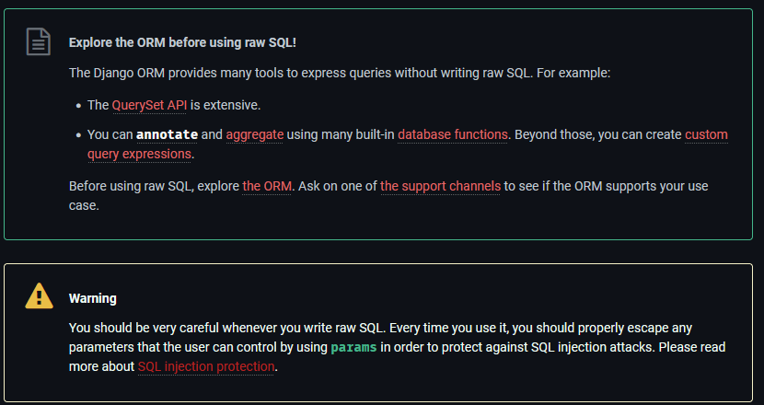
The Experts Say...

Slide 27
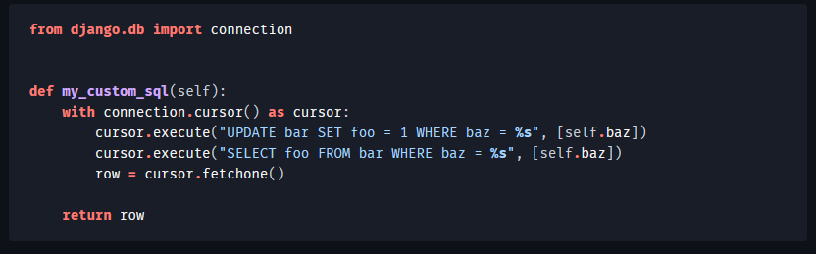
Raw SQL - mysqlclient
Notes:
Another option for using raw SQL is to use the underlying mysqlclient directly
https://docs.djangoproject.com/en/5.1/topics/db/sql/

Slide 28
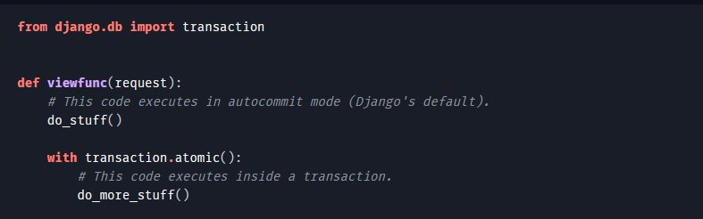
Transactions
Is auto-commit on or off for Django (by default)?
Database auto-commit is on, however the queries are "lazy"
Each query (SELECT, INSERT, UPDATE, DELETE) is committed immediately once it reaches the database
Transactions:
Notes:
Using transaction.atomic as a context manager ensures that the START TRANSACTION and COMMIT commands are executed when the block is entered and exited, respectively. If an operation raises an exception, then the ROLLBACK command is issued.

